Slide 1
Optimizing Multicore Task Management: An Automata-Based Hardware Scheduler Approach

Slide 2
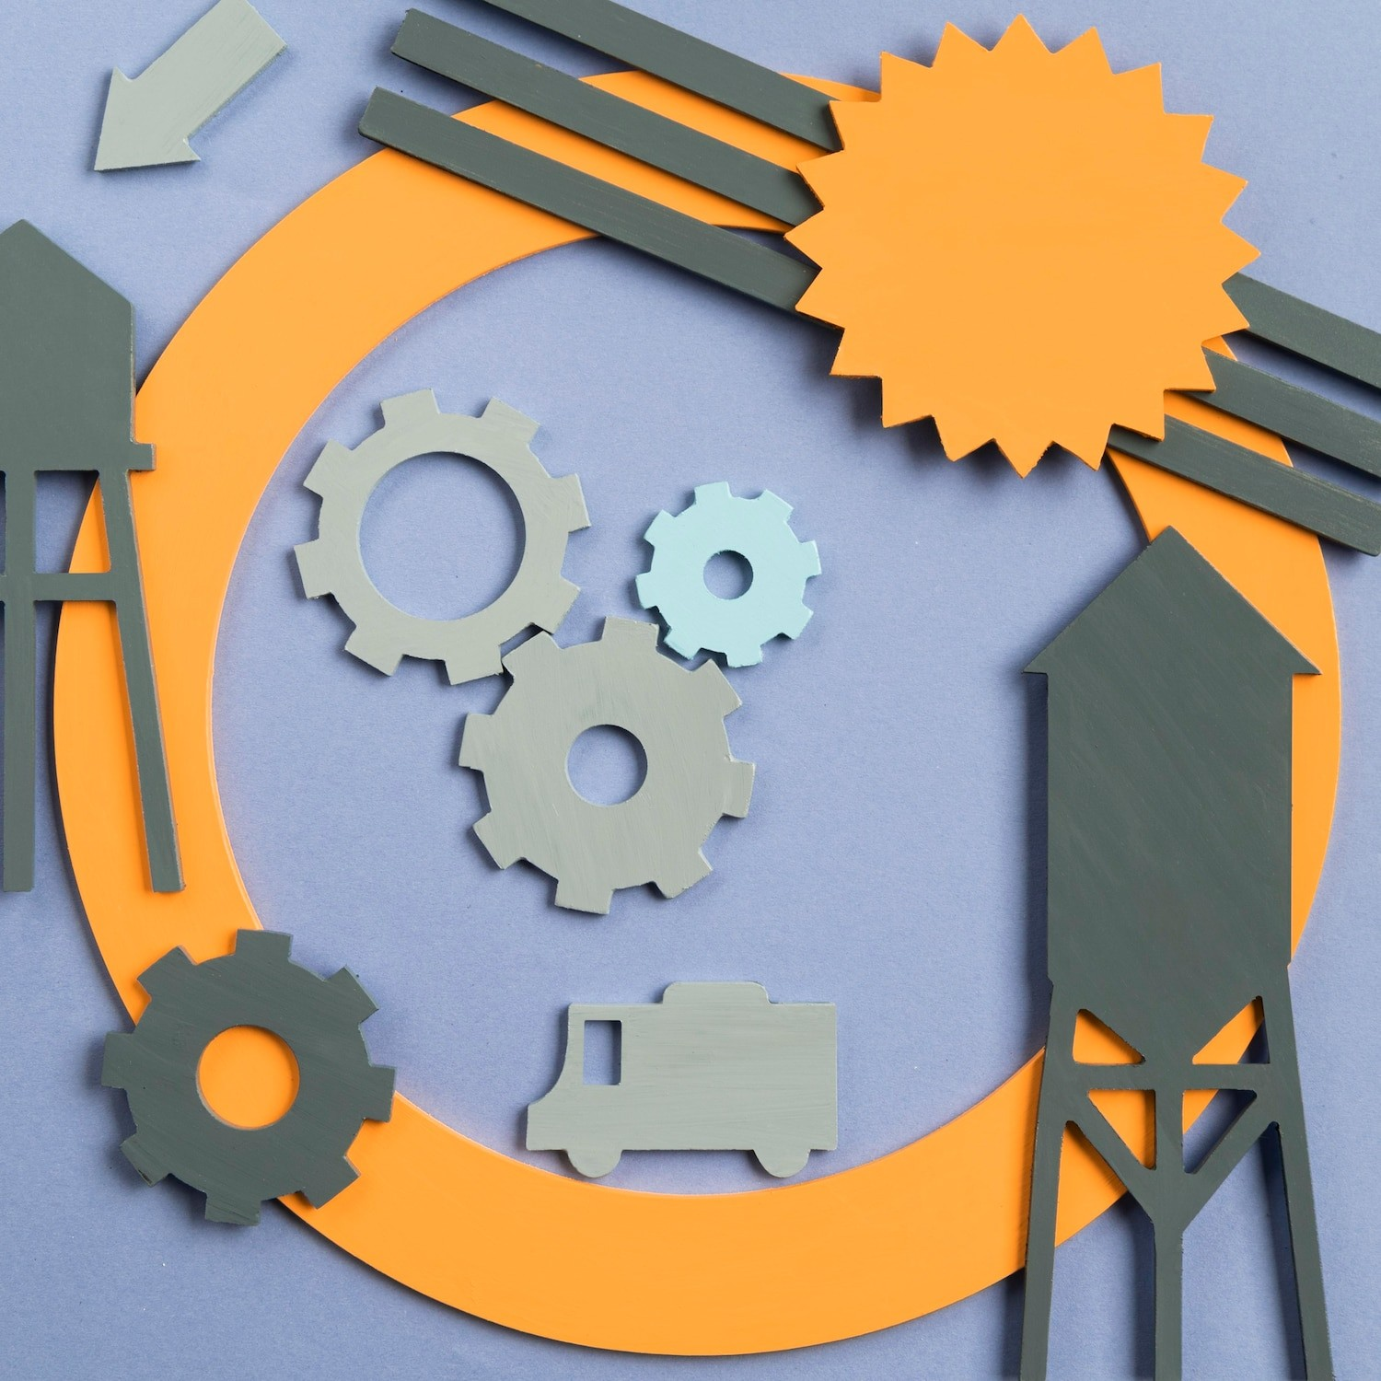
Introduction to Multicore Task Management
Multicore processors have revolutionized computing by enabling parallel processing. This presentation explores an automata-based hardware scheduler approach to optimize task management across multiple cores. We will discuss the challenges, methodologies, and beneﬁts of implementing this strategy in modern computing environments.

Slide 3







Challenges in Multicore Scheduling
Managing tasks in a multicore environment presents unique challenges such as load balancing, resource contention, and latency issues.
Understanding these challenges is crucial for developing effective scheduling algorithms that can maximize performance and efﬁciency while minimizing bottlenecks.

Slide 4
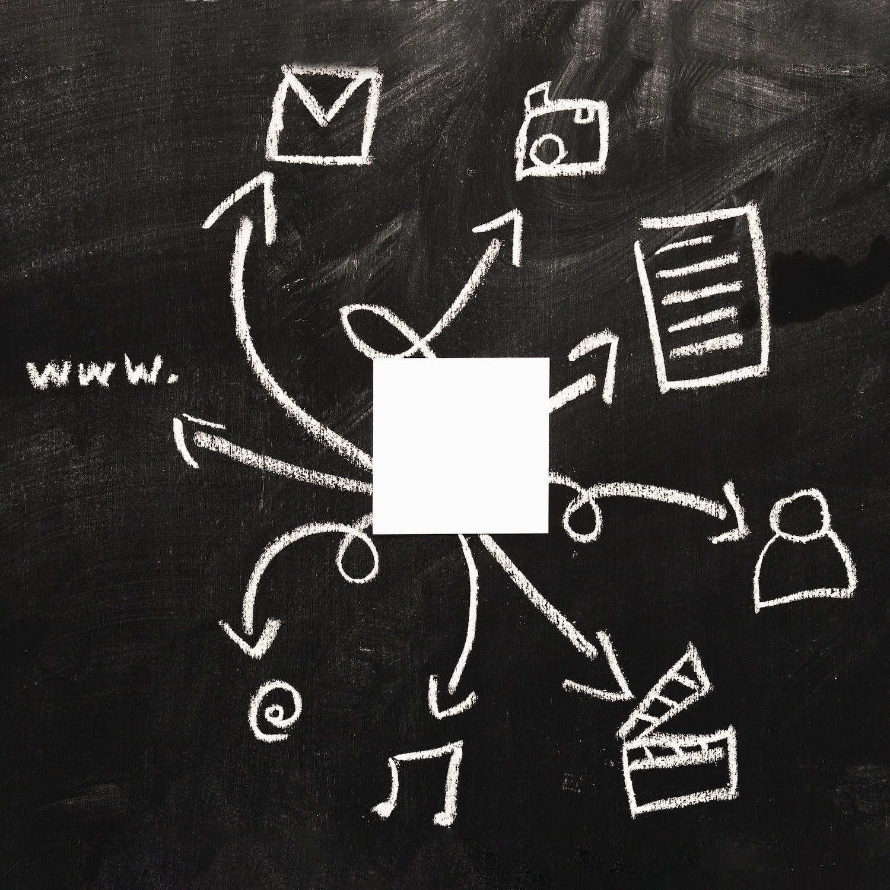
Automata-Based Scheduling Overview
The automata-based hardware scheduler utilizes state machines to make dynamic decisions about task allocation. By modeling task dependencies and resource availability, this approach allows for adaptive scheduling that can respond to changing workloads and system states.

Slide 5




Beneﬁts of Automata-Based Approach
Implementing an automata-based scheduler offers several advantages, including improved resource utilization, reduced latency, and enhanced scalability. By efﬁciently managing tasks, systems can achieve higher throughput and better overall performance in multicore architectures.

Slide 6


Case Studies and Applications
Several case studies demonstrate the effectiveness of the automata-based scheduling approach in various applications, from data centers to mobile devices. Results show signiﬁcant improvements in task execution times and resource management efﬁciency, validating this innovative method.

Slide 7
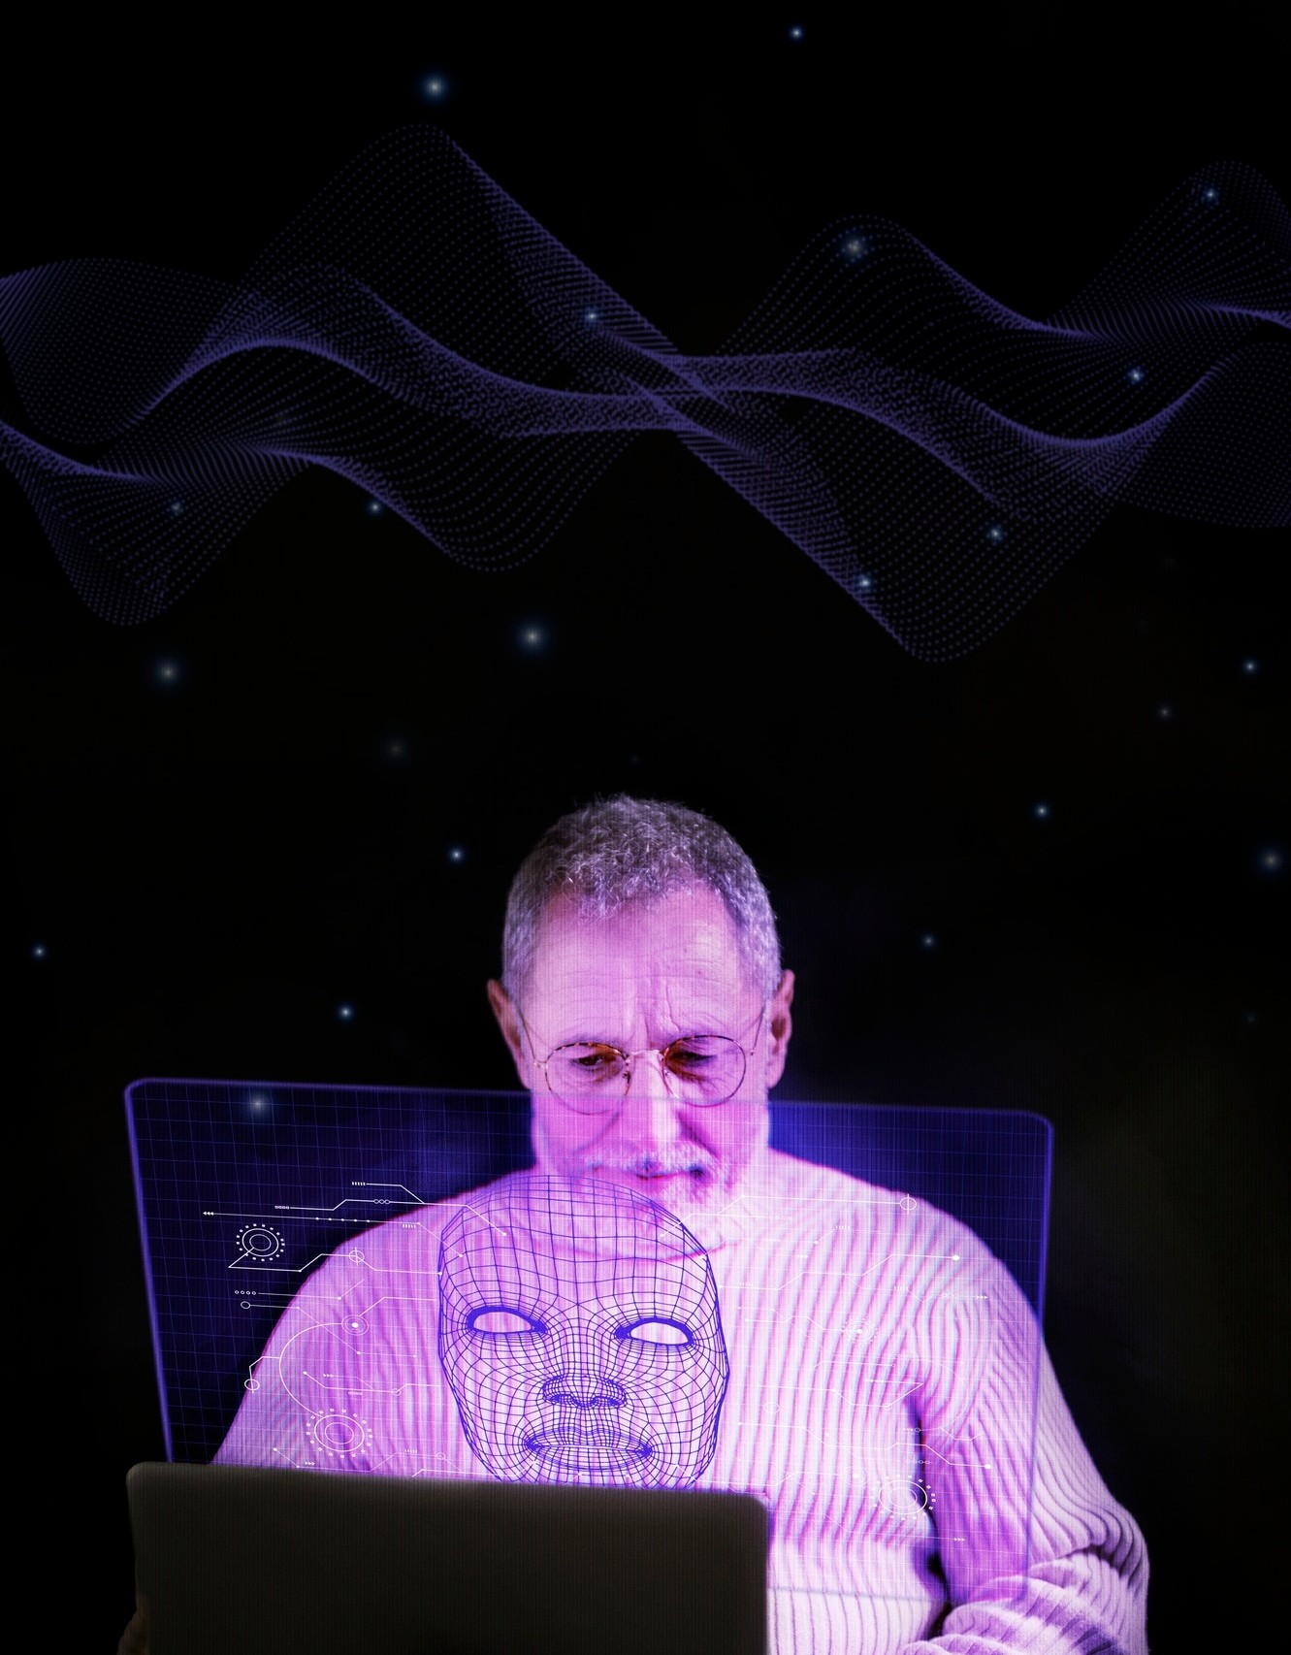


Conclusion and Future Work
In conclusion, optimizing multicore task management through an automata-based approach presents a promising avenue for enhancing computing performance.
Future work will focus on reﬁning these algorithms and exploring their applicability in emerging technologies such as edge computing and AI.

Slide 8
Thanks!

